Slide 1
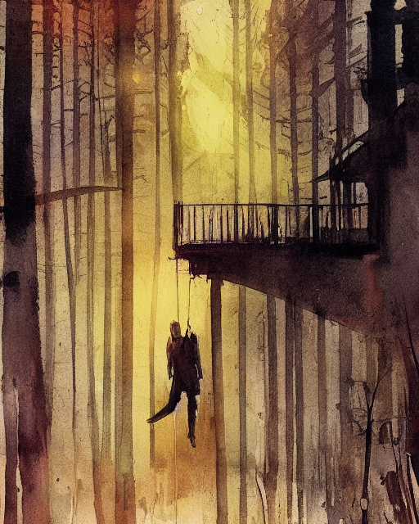
I suggest you to die
I'm not sure of what I'm doing,
I don't know if have sense,
but I can no more handle
such pressure and tense.
I heard him talking,
he was talking with them,
I think there's no time,
or I'm just getting mad.
We are all condemned,
there's nothing to do,
no place to hide,
no way to undo.
Play your game,
roll your dice,
but just don't expect
to find something nice.
It’s just an hint,
I don't know if it's wise,
but listen to me:
"I suggest you to die".
not original slides :(

